Slide 1
Defect Classification with Indeterminate Awareness Using Gaussian Process and Cross-Entropy Hybrid Models
For oral defense
Reporter：林怡瑄
Date：114/01/02
Notes:
我的論文主題是Defect Classification with Indeterminate Awareness Using Gaussian Process and Cross-Entropy Hybrid Models
(基於 GPCE 混合模型與不確定性處理的精確瑕疵分類研究)

Slide 2
Revise History
Date | Description
2024/11/21 | Initial version
2024/12/06 | Add Research process , overkill rate , leakage rate

Slide 3
Steps in the Research Process
Introduction : Goal , Challenge , Solution
Define the Research Topic and Objectives
Dataset Preparation : PCB dataset
Related works : Gaussian Process,GPCE hybrid model
Foundation Building
Research method : Implement of GPCE hybrid model
Design the Research Methodology
Research Result : learning curve , t-sne visualization , (extended)confusion matrix , evaluation metrics
Conclusion
Conduct Experiments and Gather Results
Notes:
首先，我定義研究的主題和目標，這部分會在introduction作介紹，接著準備資料集以及了解相關背景知識，在基礎建立好之後，以GPCE hybrid model的架構推廣到瑕疵分類上，最後通過learning curve ,t-sne visualization, confusion matrix, evaluation metrics來驗證及分析最後結果。

Slide 4
CONTENTS
01
Introduction
04
Research Results
02
Related works
05
Conclusion
03
Research Methods
Notes:
果。
接下來的報告，我們分為introduction, related works, research methods, research results, conclusion五個章節來介紹。

Slide 5
Introduction
PART ONE

Slide 6
Part1: Introduction
Goal
Our goal is to refine the architecture of the previously proposed defect detection model in our laboratory, transforming it into a system for defect classification.
The previously proposed defect detection model includes two branches: the upper branch is a cross-entropy-based defect detector, and the lower branch comprises a Gaussian-process-based component classifier and a converter for transforming component classification into defect detection.
Challenge
Although we got good performance on predict the samples good or bad, but we can’t sure that would get good performance on each defect type.
Solution
Replace the binary (good/bad) classifier with a multi-class classifier on the upper branch of the hybrid model.
Combining three independent defect detectors through a one-vs-all classification framework.
Notes:
在problem definition上，我們的目標是將之前實驗室在瑕疵檢測提出的GPCE hybrid model改良使其可使用在瑕疵分類上，使我們的模型不單能找出生產出來的不良品將其剔除，還能判斷其為哪一種瑕疵種類，使我們能更容易找出生產過程的問題，雖然在瑕疵檢測上我們提出的模型已取得良好的結果，但我們不確定能不能在瑕疵分類上也得到同樣的提升，因此我們先提出兩種方法來做分析比較，分別是將GPCE hybrid model的upper branch由binary classifier改成4-class classifier以及針對每一個瑕疵種類訓練出defect detector並結合三者。

Slide 7
Part1: Introduction
PCB dataset - overview
Number of images | 136,4400
Component types | 35
Defect types | 6 (good, missing, shift,stand,broke,short)
Label information | Each image is labeled with 1 type of component and 1 type of defect.
Table 1.1 : overview of PCB dataset in initial version
Notes:
接下來的研究會使用PCB dataset來做實驗，以下是PCB dataset的介紹，在資料集中總共有136萬4400張的圖片，這些圖片可以分為35個元件種類或是6個瑕疵種類，因此每張圖片會各有一個元件種類的標籤及瑕疵種類的標籤。

Slide 8
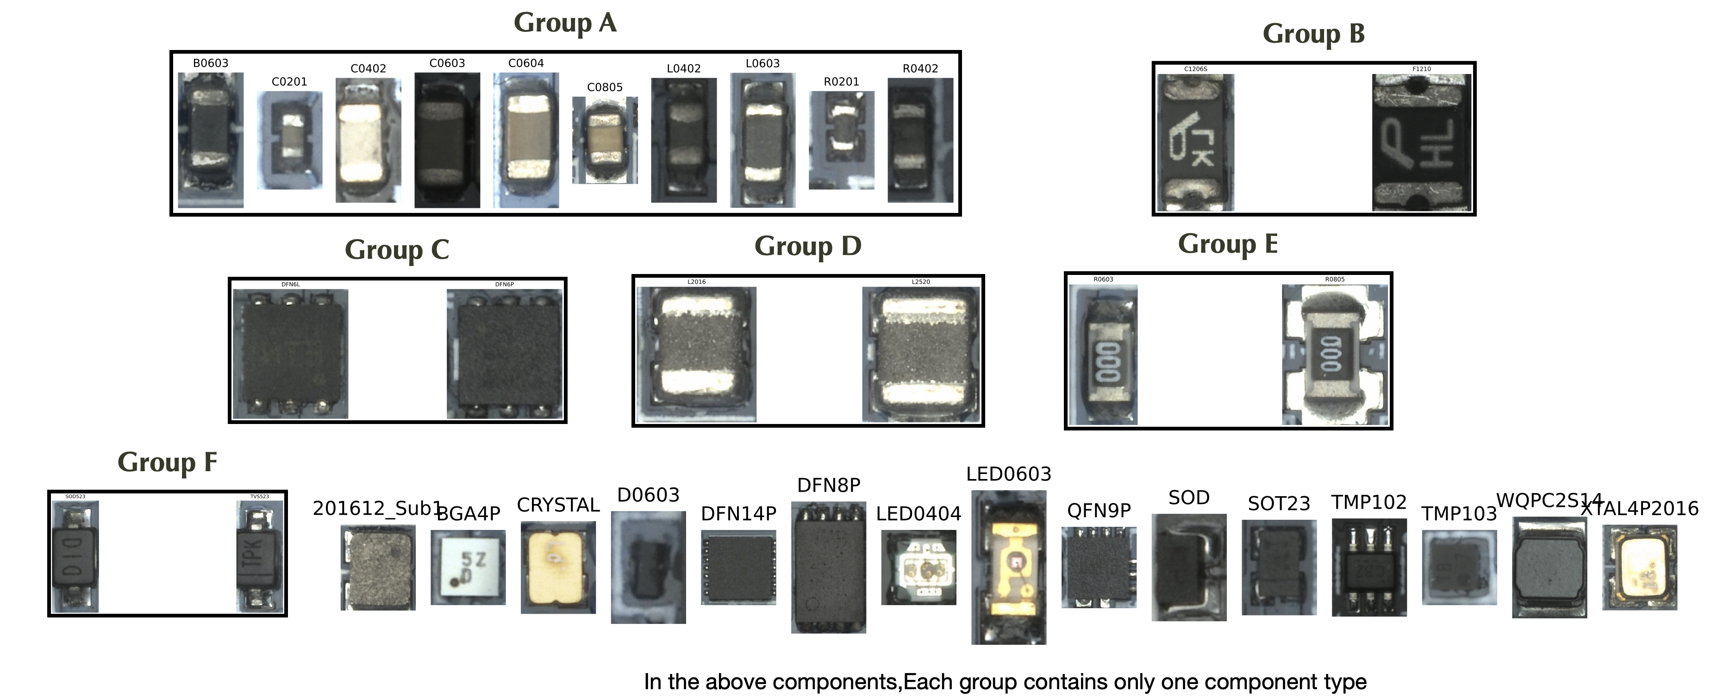
Part1: Introduction
PCB dataset - component regrouping
Notes:
我們會先將元件種類重新做分群，將外觀相似的元件種類組成同一元件種類，避免在訓練時著重在相似元件種類的類別分類上，造成過度擬合的情況。我們將此步驟稱作component regroup

Slide 9
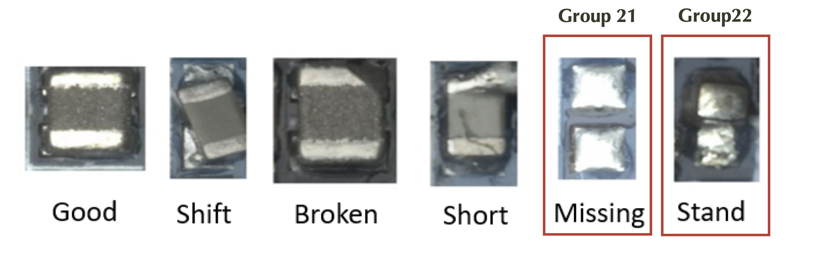
Part1: Introduction
PCB dataset – defect types
Missing and standing samples are difficult to be visually recognized as specific components. We treat them as two separate components.
Notes:
而瑕疵種類的外觀上，因為missing跟stand的外觀跟原先無瑕疵的同樣元件差異較大，使得訓練上無法準確的分類為原元件種類，故我們將這兩種瑕疵種類拉出來當作獨立的元件種類。

Slide 10
Part1: Introduction
PCB dataset - number of each component group
 | Component name relabeling | Component name | Total | good | shift | broke | short | missing | stand
0 | 201612_Sub1 | ['201612_Sub1'] | 204 | 204 | 0 | 0 | 0 | - | -
1 | Group A | ['C0604', 'C0201', 'B0603', 'L0402', 'R0402', 'C0805', 'C0603', 'L0603', 'C0402', 'R0201'] | 137641 | 108845 | 11292 | 10513 | 6991 | - | -
2 | Group B | ['F1210', 'C1206S'] | 9792 | 9704 | 88 | 0 | 0 | - | -
3 | BGA4P | ['BGA4P'] | 3057 | 2777 | 178 | 102 | 0 | - | -
4 | Group C | ['DFN6P', 'DFN6L'] | 56 | 56 | 0 | 0 | 0 | - | -
5 | CRYSTAL | ['CRYSTAL'] | 6300 | 6078 | 76 | 146 | 0 | - | -
6 | Group D | ['L2016', 'L2520'] | 37458 | 34294 | 1245 | 1479 | 440 | - | -
7 | D0603 | ['D0603'] | 4049 | 4049 | 0 | 0 | 0 | - | -
8 | DFN14P | ['DFN14P'] | 40 | 40 | 0 | 0 | 0 | - | -
9 | DFN8P | ['DFN8P'] | 370 | 370 | 0 | 0 | 0 | - | -
10 | Group E | ['R0805', 'R0603'] | 1679 | 1084 | 449 | 146 | 0 | - | -
11 | Group F | ['TVS523', 'SOD523'] | 6089 | 5437 | 310 | 342 | 0 | - | -
12 | LED0404 | ['LED0404'] | 234 | 234 | 0 | 0 | 0 | - | -
13 | LED0603 | ['LED0603'] | 306 | 306 | 0 | 0 | 0 | - | -
14 | QFN9P | ['QFN9P'] | 773 | 767 | 4 | 2 | 0 | - | -
15 | SOD | ['SOD'] | 144 | 144 | 0 | 0 | 0 | - | -
16 | SOT23 | ['SOT23'] | 12568 | 11542 | 588 | 438 | 0 | - | -
17 | TMP102 | ['TMP102'] | 4634 | 4196 | 292 | 146 | 0 | - | -
18 | TMP103 | ['TMP103'] | 157 | 157 | 0 | 0 | 0 | - | -
19 | WQPC2S14 | ['WQPC2S14'] | 46 | 46 | 0 | 0 | 0 | - | -
20 | XTAL4P2016 | ['XTAL4P2016'] | 10 | 10 | 0 | 0 | 0 | - | -
21 | Group 21 |  | 149341 | - | - | - | - | 149341 | -
22 | Group 22 |  | 13767 | - | - | - | - | - | 13767
Table 1.2 : number of each component group in initial version
Notes:
以下是做完regroup調整後的資料集在每一元件的樣本數量，因為我們的研究會觀察在特定元件上的瑕疵分類成果，因此我們會先將沒有其他瑕疵種類的元件種類剔除，以便實驗結果的觀察

Slide 11
Part1: Introduction
PCB dataset - Version for our experiment
Number of images | 219991
Component types | 10
Defect types | 4 (good, shift, broke, short)
Label information | Each image is labeled with 1 type of component and 1 type of defect.
Table 1.3 : overview of PCB dataset in our version
 | Component name relabeling | Component name | Total | good | shift | broke | short
1 | Group A | ['C0604', 'C0201', 'B0603', 'L0402', 'R0402', 'C0805', 'C0603', 'L0603', 'C0402', 'R0201'] | 137641 | 108845 | 11292 | 10513 | 6991
2 | Group B | ['F1210', 'C1206S'] | 9792 | 9704 | 88 | 0 | 0
3 | BGA4P | ['BGA4P'] | 3057 | 2777 | 178 | 102 | 0
5 | CRYSTAL | ['CRYSTAL'] | 6300 | 6078 | 76 | 146 | 0
6 | Group D | ['L2016', 'L2520'] | 37458 | 34294 | 1245 | 1479 | 440
10 | Group E | ['R0805', 'R0603'] | 1679 | 1084 | 449 | 146 | 0
11 | Group F | ['TVS523', 'SOD523'] | 6089 | 5437 | 310 | 342 | 0
14 | QFN9P | ['QFN9P'] | 773 | 767 | 4 | 2 | 0
16 | SOT23 | ['SOT23'] | 12568 | 11542 | 588 | 438 | 0
17 | TMP102 | ['TMP102'] | 4634 | 4196 | 292 | 146 | 0
Table 1.4 : number of each component group in our version
Notes:
最終的實驗版本會有21萬9991張的圖片，10個元件種類跟4個瑕疵種類，下面表格是每個元件種類的瑕疵數量。

Slide 12
Part1: Introduction
Definition of old / new component
Old component
Old components refer to component types that are more prevalent in the training dataset. These components have been part of the training dataset for a longer period, resulting in a larger number of samples, including more good type and defect type samples. Due to their extensive inclusion in the training process, the characteristics and defect detection reliability of these components are well-established and optimized.
New component
New components refer to component types that have been recently added to the training dataset. Since these components were introduced later, the available defect type samples are relatively fewer, potentially leading to less comprehensive training and detection accuracy compared to old components. However, the inclusion of new components helps to expand and update the training dataset, enhancing the model's ability to adapt to the latest technologies and manufacturing processes.
 | Sample availability during training | Sample availability during testing
Old | Normal type samples : many Defect type samples : many | Normal type samples : enough Defect type samples : enough
New | Normal type samples : many Defect type samples : few or none | Normal type samples : enough Defect type samples : enough
Table 1.5 : comparison of old/new component
Notes:
除此之外，我們發現在收集資料集時，新開始生產的元件種類不一定都能收集到足夠的瑕疵數量，我們將此問題在以下做定義，我們將元件分為new component與old component兩種，我們將已長期在產線中生產，並收集了充足的各瑕疵種類樣本數量的元件種類稱作old component，而剛開始加入產線，還沒收集充足的樣本數量的元件種類為new component，因此在訓練集的舊元件有足夠的normal與瑕疵樣本，新元件的瑕疵樣本數量極少甚至完全沒有，而在測試集中新舊元件都有足夠的normal與瑕疵樣本，足以觀察我們的研究方法在新舊元件的實驗結果。

Slide 13
Part1: Introduction
Data split between train/valid/test dataset
Sample of all components(10 components)
Sample of old components (5 components)
Sample of new components (5 components)
normal samples
defect samples
Sample of new components (2 components)
Sample of new components (3 components)
normal samples
defect samples
normal samples
defect samples
normal samples
defect samples
normal samples
normal samples
normal samples
defect samples
normal samples
defect samples
Defect classifier training set
50% normal samples of each new components for the training set
Normal samples
defect samples
normal samples
80% of the old component samples are used for the training set.
Test set
Only normal samples in defect training set are used for component training set.
normal samples
normal samples
normal samples
Validation set
10% of the old component samples are used for the test set.
10% of the old component samples are used for the validation set.
Component classifier training set
Notes:
Data split上，我們會依據上述old/new component的定義來做分配，這邊可以看出我們將old component的所有樣本按比例分配到training/validation/test set,而new component只在test set會有bad sample，training/validation上只有new component的good sample，而用來做component分類的component training set只會包含整個training set的good sample

Slide 14
Part1: Introduction
Data split between train/valid/test dataset
 | Training set |  | Validation set | Test set
 | Defect classifier training set | Component classifier training set
Old | Normal sample : 80% Defect sample :80% | Normal sample : 80% Defect sample : 0% | Normal sample : 10% Defect sample : 10% | Normal sample : 10% Defect sample : 10%
New | Normal sample : 50% of all 5 components Defect sample : 0% | Normal sample : 50% of all 5 components Defect sample : 0% | Normal sample : 50% of 2 components Defect sample : 0 % | Normal sample : 50% of 3 components Defect sample : 100% of 3 components
Table 1.6 : comparison of training/validation/test set
Notes:
這邊將分配後的結果做整理

Slide 15
Related work
PART TWO

Slide 16
Part2: Related Work
Gaussian process
Gaussian process classifier
Gaussian process use a latent function to represent the underlying distribution of each class. These functions are distributed according to a multivariate Gaussian distribution, and they allow us to determine the likelihood of the input belonging to a particular class.
Prototypical Gaussian process classifier
In the 1st stage of training, we set inducing points to be the same as the number of component types, and then we fix the model parameters of the feature extractor to enhance the training of the gaussian process classifier. We called this as Prototypical Gaussian process classifier.
Converting Gaussian process component-type classifier to defect-type classifier(our previous work)
We utilize the intrinsic property of GP to be able to output both the predicted value and its uncertainty, and apply it to the detection of defective components, and indeterminate the data with too large uncertainty.
Notes:
我們利用了Gaussian process會在每一個類別形成一個gaussian distribution的特性，使我們能藉此得到樣本在所判定類別的likelihood。除此之外，我們在第一階段設定inducing point與類別個數相同，使得模型能更好的收斂;並在第二階段固定feature extractor後，將inducing point增強為50倍，加強gaussian process classifier的訓練，我們將這過程稱作prototypical gaussian process classifier，在我們的方法中，藉由分類component type得到的likelihood轉換為估計瑕疵,indeterminate的uncertainty來達成對瑕疵的判定。

Slide 17
Part3: Related Work
GPCE-Hybrid model for defect detection (our previous work)
high
high
low
low
Uncertainty
Uncertainty
Expert 1 : binary-class(good/bad) classifier by MLP and cross entropy
Expert 2 : component classifier by gaussian process
Hybrid expert 1 & expert2 and share their feature extractor
high
 | good samples in old component
 | bad samples in old component
 | good samples in new component
 | bad samples in new component
low
Hybrid expert
Uncertainty
Notes:
Gaussian process and cross entropy hybrid model，接下來會稱作GPCE hybrid model，在defect detection上的GPCE hybrid model，expert1使用MLP+cross entropy分類是否有瑕疵，expert2使用gaussian process分類元件種類，在expert1上會因為new component瑕疵元件不足的問題導致new component上的判別效果較差，為解決這一問題，我們使用hybrid expert的方式結合expert1與expert2，使得驗證時可以藉由gaussian process將new component的瑕疵元件等模型在訓練時沒看過的元件估計較高的uncertainty再將其判定為瑕疵或是indeterminate。

Slide 18
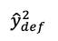
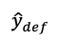

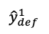
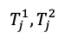
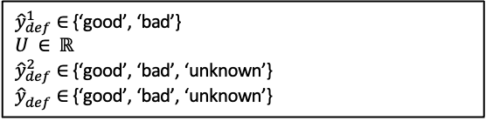
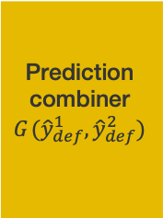
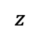
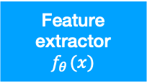
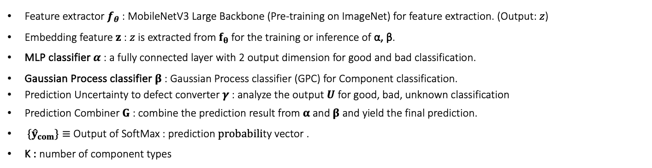
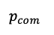

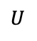
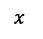
Part2: Related Work
Previously proposed GPCE-Hybrid model(gaussian process and cross entropy hybrid model)
Feature extractor $f_{θ}$ : MobileNetV3 Large Backbone (Pre-training on ImageNet) for feature extraction. (Output: $z$)
Embedding feature $z$ : $z$ is extracted from $f_{θ}$ for the training or inference of α, β.
MLP classifier $α$ : a fully connected layer with 2 output dimension for good and bad classification.
Gaussian Process classifier $β$ : Gaussian Process classifier (GPC) for Component classification.
Prediction Uncertainty to defect converter$γ$: analyze the output $U$ for good, bad, unknown classification
Prediction Combiner $G$ : combine the prediction result from$α$ and$β$ and yield the final prediction.
${\{\hat{y}}_{com}\}≡$ Output of SoftMax : prediction $probabili$ty vector .
K : number of component types
${\hat{y}}_{def}^{1}∈$ {‘good’, ‘bad’}
$$U ∈ ℝ$$
${\hat{y}}_{def}^{2}∈$ {‘good’, ‘bad’, ‘unknown’}
${\hat{y}}_{def}^{ }∈$ {‘good’, ‘bad’, ‘unknown’}
MLP classifier
$$α_{ }(z)$$
$${\hat{y}}_{def}^{1}$$
Prediction combiner
$$G_{ }({\hat{y}}_{def}^{1},{\hat{y}}_{def}^{2})$$
$$x_{ }$$
Feature extractor
$$f_{θ_{ }}(x)$$
$$z_{ }$$
$${\hat{y}}_{def}^{ }$$
$$T_{j_{ }}^{1},{T_{j_{ }}^{2}}_{ }$$
Gaussian process classifier
$$β_{ }(z)$$
Probabilities to predict uncertainty converter
predict uncertainty to defect converter
$${p_{com}}_{ }$$
$$U_{ }$$
$${\hat{y}}_{def}^{2}$$
Notes:
下圖是GPCE hybrid model的流程，會先經由一個共通的mobile net v3提取出樣本特徵，upper branch使用MLP classifier判別出瑕疵與否作為y^1_def，lower branch藉由gaussian process classifier對元件的不確定性轉換成瑕疵與否的估計，得到y^2_def，結合兩者得到最後的y_def。

Slide 19
Research Methods
PART THREE

Slide 20
Part3: Research method
GPCE-Hybrid model for defect classification -
Baseline : Multi-defect-type classifier
Use only the MLP classifier to categorize multi-defect types.
Method 1 : A modified hybrid expert, incorporating both multi-defect-type and multi-component-type classifier In expert1, we implement binary-class (good/bad) MLP classifier into 4-class(good/shift/broke/short) MLP classifier ,such that we can classify multi-defect types.
In Expert 2, we only use good samples for component classification, using the uncertainty of the gaussian process classifier for each component type to determine good/bad/unknown.
Method 2 : One-vs-all classification framework , 3 hybrid experts (each expert incorporating both single-defect-type and multi-component-type classifier)
Based on the concept of one-vs-all, we train 3 hybrid experts for guided defect detector (shift/not shift, broke/not broke, short/not short) and merge the 3 to get the classification result of defect types.
Notes:
首先在research method會先介紹baseline的架構，只使用MLP classifier得到的瑕疵分類結果作為最後的判定結果，接著是我們以GPCE hybrid model推廣出的method1及method2，method1是將expert1的binary class MLP classifier改為4-class MLP classifier，使模型可判別出瑕疵的種類，並在expert2分類時只使用good sample做gaussian process classifier做元件分類，利用不確定性轉換為瑕疵與否的偵測，在method2，我們針對3個瑕疵種類shift, broke, short分別訓練3個GPCE hybrid models，並將3個結果結合為最後的瑕疵分類結果。

Slide 21
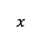
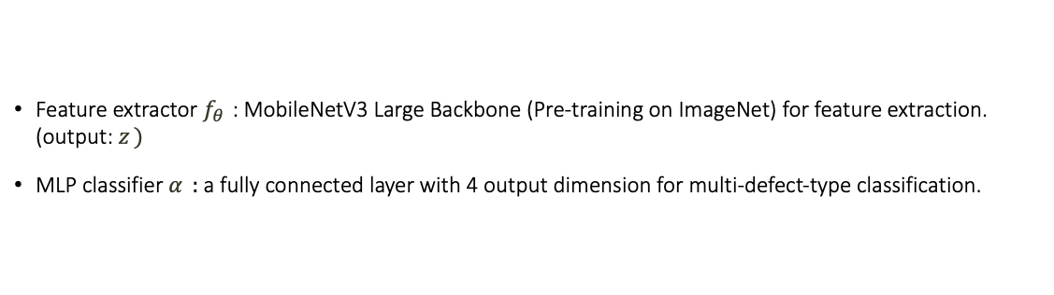
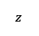
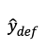
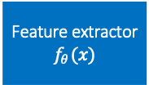
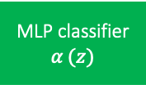
Part3: Research method
Baseline : multi-defect-type classifier
Feature extractor $f_{θ_{ }}$ : MobileNetV3 Large Backbone (Pre-training on ImageNet) for feature extraction. (output: $z_{ })$
MLP classifier $α_{ }$ : a fully connected layer with 4 output dimension for multi-defect-type classification.
$${\hat{y}}_{def}^{ }∈\left\{’good’,’shift’,’broke’,’short’\right\}$$
$$x_{ }$$
Feature extractor
$$f_{θ_{ }}(x)$$
$$z_{ }$$
MLP classifier
$$α_{ }(z)$$
$${\hat{y}}_{def}^{ }$$
Notes:
首先Baseline是經由一個mobile net v3 large的feature extractor提取出樣本的特徵z，再經由MLP classifier輸出瑕疵種類的分類結果(good, shift, broke, short);

Slide 22
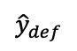
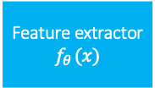
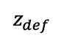
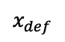
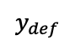
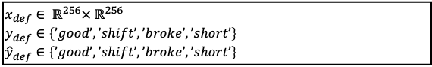
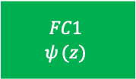
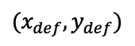
Part3: Research method
training procedure of Baseline
$$x_{def}∈ ℝ^{256}× ℝ^{256}$$
$$y_{def}^{ }∈\left\{’good’,’shift’,’broke’,’short’\right\}$$
$${\hat{y}}_{def}^{ }∈\left\{’good’,’shift’,’broke’,’short’\right\}$$
$$y_{def}$$
$${(x}_{def},y_{def})$$
$$x_{def}$$
Feature extractor
$$f_{θ_{ }}(x)$$
$$z_{def}$$
$$FC1$$
$$ψ_{ }(z)$$
$${\hat{y}}_{def}$$
Cross entropy loss
Notes:
訓練過程中我們會透過cross entropy loss的結果來更新feature extractor與MLP classifier的參數。

Slide 23
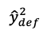
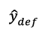

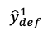
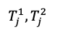
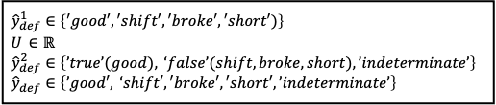
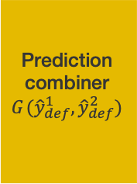
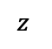
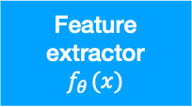
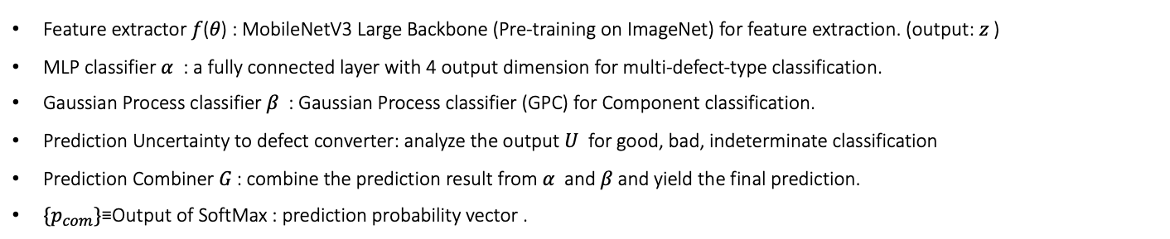
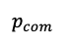
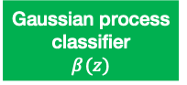
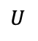
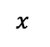
Part3: Research method
Method 1 : a Hybrid Expert, incorporating both Multi-Defect-Type and Multi-Component-Type Classifier
Feature extractor 𝑓(𝜃) : MobileNetV3 Large Backbone (Pre-training on ImageNet) for feature extraction. (output: 𝑧 )
MLP classifier 𝛼 : a fully connected layer with 4 output dimension for multi-defect-type classification.
Gaussian Process classifier 𝛽 : Gaussian Process classifier (GPC) for Component classification.
Prediction Uncertainty to defect converter: analyze the output 𝑈 for good, bad, indeterminate classification
Prediction Combiner 𝐺 : combine the prediction result from 𝛼 and 𝛽 and yield the final prediction.
$\{p_{com}\}$≡Output of SoftMax : prediction probability vector .
$${\hat{y}}_{def}^{1}∈\left\{′good′,′shift′,′broke′,′short′)\right\} \\ U_{ }∈ℝ \\ {\hat{y}}_{def}^{2}∈\left\{’true’(good), ‘false’(shift,broke,short),’indeterminate’\right\} \\ {\hat{y}}_{def}^{ }∈\left\{’good′, ‘shift′,′broke′,′short′,’indeterminate’\right\}$$
MLP classifier
$$α_{ }(z)$$
$${\hat{y}}_{def}^{1}$$
Prediction combiner
$$G_{ }({\hat{y}}_{def}^{1},{\hat{y}}_{def}^{2})$$
$$x_{ }$$
Feature extractor
$$f_{θ_{ }}(x)$$
$$z_{ }$$
$${\hat{y}}_{def}^{ }$$
$$T_{j_{ }}^{1},{T_{j_{ }}^{2}}_{ }$$
Gaussian process classifier
$$β_{ }(z)$$
Probabilities to predict uncertainty converter
predict uncertainty to defect converter
$${p_{com}}_{ }$$
$$U_{ }$$
$${\hat{y}}_{def}^{2}$$
Notes:
method1一樣是以mobile net v3 large作為feature extractor提取特徵z後，在upper branch上使用MLP classifier判斷出瑕疵的種類，在lower branch，使用gaussian process分類元件估計的probability轉換成瑕疵的偵測結果(true, false, indeterminate)，最後再經由prediction combiner將其整合成最後的結果。

Slide 24
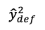
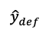
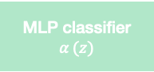
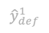
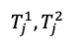
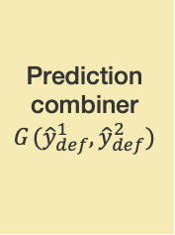
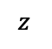
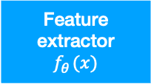
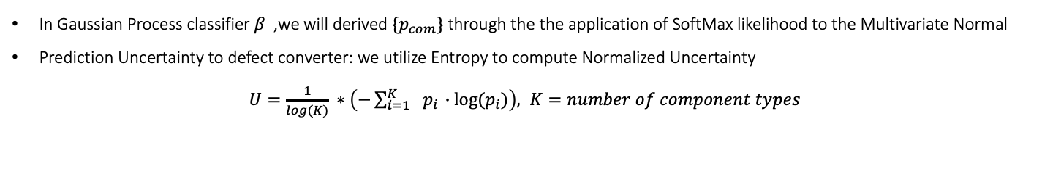



Part3: Research method
Method 1 : a Hybrid Expert, incorporating both Multi-Defect-Type and Multi-Component-Type Classifier
MLP classifier
$$α_{ }(z)$$
$${\hat{y}}_{def}^{1}$$
Prediction combiner
$$G_{ }({\hat{y}}_{def}^{1},{\hat{y}}_{def}^{2})$$
$$x_{ }$$
Feature extractor
$$f_{θ_{ }}(x)$$
$$z_{ }$$
$${\hat{y}}_{def}^{ }$$
$$T_{j_{ }}^{1},{T_{j_{ }}^{2}}_{ }$$
Gaussian process classifier
$$β_{ }(z)$$
Probabilities to predict uncertainty converter
predict uncertainty to defect converter
$${p_{com}}_{ }$$
$$U_{ }$$
$${\hat{y}}_{def}^{2}$$
In Gaussian Process classifier 𝛽 ,we will derived $\{p_{com}\}$ through the the application of SoftMax likelihood to the Multivariate Normal
Prediction Uncertainty to defect converter: we utilize Entropy to compute Normalized Uncertainty
$U=\frac{1}{log(K)} ∗\left(−\sum_{i=1}^{K}{ }{ p}_{i} ∙log⁡(p_{i})\right), K=number of component types$
Notes:
Gaussian process classifier判定為每個元件probabilities:p_com轉換成uncertainty我們是採用entropy的公式帶入p_com後再除以log(K)得到正規化的uncertainty結果。

Slide 25










Part3: Research method
Method 1 : a Hybrid Expert, incorporating both Multi-Defect-Type and Multi-Component-Type Classifier
MLP classifier
$$α_{ }(z)$$
$${\hat{y}}_{def}^{1}$$
Prediction combiner
$$G_{ }({\hat{y}}_{def}^{1},{\hat{y}}_{def}^{2})$$
$$x_{ }$$
Feature extractor
$$f_{θ_{ }}(x)$$
$$z_{ }$$
$${\hat{y}}_{def}^{ }$$
$$T_{j_{ }}^{1},{T_{j_{ }}^{2}}_{ }$$
Gaussian process classifier
$$β_{ }(z)$$
Probabilities to predict uncertainty converter
predict uncertainty to defect converter
$${p_{com}}_{ }$$
$$U_{ }$$
$${\hat{y}}_{def}^{2}$$
We convert $U$ into ${\hat{y}}_{def}^{2}$ = $\{good, bad, indeterminate\}$by two predefined thresholds $T_{j_{ }}^{1},{T_{j_{ }}^{2}}_{ }$.
We optimize $T_{j_{ }}^{1},{T_{j_{ }}^{2}}_{ }$ by Bayesian optimizer in order to find the best harmonic mean of overkill rate , leakage rate , indeterminate rate
$Harmonic mean=$ $\frac{a+b+c}{\frac{a}{\exp\left(Overkill rate \right)}+\frac{b}{\exp\left(Leakage rate \right)}+\frac{c}{\exp\left(indetertminate rate \right)}} , a=b=c=1$
If $U>T_{j}^{2}$, ${\hat{y}}_{def}^{2}=indeterminate$
If $T_{j}^{2}≥ U>T_{j}^{1}$, ${\hat{y}}_{def}^{2}=bad$
If $U≤T_{j}^{1}$, ${\hat{y}}_{def}^{2}=good$
$${\hat{y}}_{def}^{2}$$
good
bad
indeterminate
$$U_{ }$$
0
$$T_{j}^{1}$$
$$T_{j}^{2}$$
1
Notes:
接著再將uncertainty使用threshold T1,T2分類，判斷樣本為good, bad, indeterminate，uncertainty大於T2時代表gaussian process classifier對於該樣本不確定性極高，因此判為indeterminate，當uncertainty介於T1,T2中間時，判為false,小於T1時判為true，而threshold我們是使用bayeian optimizer藉由harmonic score找出最佳的值。

Slide 26

Part3: Research method
Method 1 : Prediction Combiner $G_{ }$ in method1
$defect∈\{shift,broke,short\}$
If ${\hat{y}}_{def}^{1}=good$ and ${\hat{y}}_{def}^{2}=true$ , then ${\hat{y}}_{def}^{ }=good$
Else If ${\hat{y}}_{def}^{1}=defect$ and ${\hat{y}}_{def}^{2}=false$ ,then ${\hat{y}}_{def}^{ }={\hat{y}}_{def}^{1}$
Else if (${\hat{y}}_{def}^{1}=good$ and ${\hat{y}}_{def}^{2}=false$) or (${\hat{y}}_{def}^{1}=defect$ and ${\hat{y}}_{defect}^{2}=true$) or (${\hat{y}}_{def}^{2}=indeterminate$ ), then ${\hat{y}}_{def}^{ }=indeterminate$
Notes:
最後在prediction combiner，若y^1_def判定為good且y^2_def為true時，y_hat_def為good，若y^1_def分類為瑕疵的其中一種且y^2_def為false時，y_hat_def判為該種defect，若y^1_def與y^2_def結果不一致或y^2_def直接判為indeterminate時，y_hat_def判為indeterminate。

Slide 27























Part3: Research method
training procedure of Method1
Stage1 :
$$y_{def}$$
$${(x}_{def},y_{def})$$
$$x_{def}$$
Feature extractor
$$f_{θ_{ }}(x)$$
$$z_{def}$$
$$FC_{def}$$
$$ψ_{ }(z)$$
$${\hat{y}}_{def}$$
Cross entropy loss
$$y_{com}$$
Share weight
$${(x}_{com},y_{com})$$
$$x_{com}$$
Feature extractor
$$f_{θ_{ }}(x)$$
$$z_{com}$$
$$GP_{com}$$
$$φ_{ }(z)$$
$${\hat{y}}_{com}$$
Variational ELBO
Inducing points = numbers of component type
Stage2 :
$$y_{com}$$
$$x_{def}∈ ℝ^{256}× ℝ^{256}$$
$${\hat{y}}_{def}^{ }∈\left\{’good’,’shift’,’broke’,’short’\right\}$$
$${\hat{y}}_{def}^{ }∈\left\{’good’,’shift’,’broke’,’short’\right\}$$
$$x_{com}∈ ℝ^{256}× ℝ^{256}$$
$${\hat{y}}_{com}^{ }∈\left\{component type1, component type2, …\right\}$$
$${\hat{y}}_{com}^{ }∈\left\{component type1, component type2, …\right\}$$
$${(x}_{com},y_{com})$$
$$x_{com}$$
Feature extractor
$$f_{θ_{ }}(x)$$
$$z_{com}$$
$$GP_{com}$$
$$φ_{ }(z)$$
$${\hat{y}}_{com}$$
Variational ELBO
Inducing points = (numbers of component type) x 50
Notes:
Method1的訓練上使用標記為瑕疵種類的defect training set進行feature extractor與MLP classifier的訓練，並使用cross entropy loss更新模型參數，以及標記為元件種類的component training set進行feature extractor與gaussian process classifier的訓練，並使用variational ELBO更新模型參數，此外進行完第一階段訓練後，我們再第二階段固定feature extractor的參數，將inducing point增加為component type的50倍，繼續更新gaussian process classifier的參數。

Slide 28









Part3: Research method
Method 2 : One-vs-all classification framework : 3 Hybrid Experts, each expert incorporating both Single-Defect-Type and Multi-Component-Type Classifier
$$x$$
GPCE-hybrid model for shift detector
$${\hat{y}}_{shift}$$
Prediction combiner
$$G({\hat{y}}_{shift},{\hat{y}}_{broke},{\hat{y}}_{short})$$
$$x$$
GPCE-hybrid model for broke detector
$${\hat{y}}_{broke}$$
$${\hat{y}}_{ }$$
$$x$$
GPCE-hybrid model for short detector
$${\hat{y}}_{short}$$
$${\hat{y}}_{ }$$
Notes:
在method2使用3個GPCE hybrid model分別做為shift, broke, short的特定瑕疵種類偵測，再將3個分類結果整合為瑕疵分類的結果

Slide 29














Part3: Research method
Method 2 : GPCE-hybrid model (gaussian process and cross entropy hybrid model) for shift detector
Feature extractor $f_{θ_{1}}$ : MobileNetV3 Large Backbone (Pre-training on ImageNet) for feature extraction. (output: $z_{1})$
MLP classifier $α_{1}$ : a fully connected layer with 2 output dimension for single-defect-type classification.
Gaussian Process classifier $β_{1}$ : Gaussian Process classifier (GPC) for Component classification.
Prediction Uncertainty to defect converter: analyze the output $U_{1}$ for shift, not shift, indeterminate classification
Prediction Combiner $G_{1}$ : combine the prediction result from $α_{1}$ and $β_{1}$ and yield the final prediction.
$\{p_{com1}\}≡$Output of SoftMax : prediction $probabili$ty vector .
$${\hat{y}}_{shift}^{1}∈\left\{’true’(shift), ‘false’(good,broke,short)\right\} \\ U_{1}∈ℝ \\ {\hat{y}}_{shift}^{2}∈\left\{’true’(shift), ‘false’(good,broke,short),’indeterminate’\right\} \\ {\hat{y}}_{shift}^{ }∈\left\{’true’(shift), ‘false’(good,broke,short),’indeterminate’\right\}$$
MLP classifier
$${α_{1}}_{ }(z)$$
$${\hat{y}}_{shift}^{1}$$
Prediction combiner
$$G_{1}({\hat{y}}_{shift}^{1},{\hat{y}}_{shift}^{2})$$
$$x_{ }$$
Feature extractor
$$f_{{θ_{1}}_{ }}(x)$$
$$z_{ }$$
$$T_{{j_{1}}_{ }}^{1},{T_{j_{ 1 }}^{2}}_{ }$$
$${\hat{y}}_{shift}^{ }$$
Gaussian process classifier
$${β_{1}}_{ }(z)$$
Probabilities to predict uncertainty converter
predict uncertainty to defect converter
$${p_{com1}}_{ }$$
$${U_{1}}_{ }$$
$${\hat{y}}_{shift}^{2}$$
Notes:
shift detector的GPCE hybrid model會在upper branch將資料分為true為shift/false為not shift，lower branch則多了indeterminate 的估計

Slide 30












Part3: Research method
Method 2 : GPCE-hybrid model (gaussian process and cross entropy hybrid model) for broke detector
Feature extractor $f_{θ_{2}}$ : MobileNetV3 Large Backbone (Pre-training on ImageNet) for feature extraction. (output: $z_{2})$
MLP classifier $α_{2}$ : a fully connected layer with 2 output dimension for single-defect-type classification.
Gaussian Process classifier $β_{2}$ : Gaussian Process classifier (GPC) for Component classification.
Prediction Uncertainty to defect converter: analyze the output $U_{2}$ for broke, not broke, indeterminate classification
Prediction Combiner $G_{2}$ : combine the prediction result from $α_{2}$ and $β_{2}$ and yield the final prediction.
$\{p_{com2}\}≡$Output of SoftMax : prediction $probabili$ty vector .
$${\hat{y}}_{broke}^{1}∈\left\{’true’(broke), ‘false’(good,shift,short)\right\} \\ U_{2}∈ℝ \\ {\hat{y}}_{broke}^{2}∈\left\{’true’(broke), ‘false’(good,shift,short),’indeterminate’\right\} \\ {\hat{y}}_{broke}^{ }∈\left\{’true’(broke), ‘false’(good,shift,short),’indeterminate’\right\}$$
MLP classifier
$${α_{2}}_{ }(z)$$
$${\hat{y}}_{broke}^{1}$$
Prediction combiner
$$G_{2}({\hat{y}}_{broke}^{1},{\hat{y}}_{broke}^{2})$$
$$x_{ }$$
Feature extractor
$$f_{{θ_{2}}_{ }}(x)$$
$$z_{ }$$
$$T_{{j_{2}}_{ }}^{1},{T_{j_{ 2 }}^{2}}_{ }$$
$${\hat{y}}_{broke}^{ }$$
Gaussian process classifier
$${β_{2}}_{ }(z)$$
Probabilities to predict uncertainty converter
predict uncertainty to defect converter
$${p_{com2}}_{ }$$
$${U_{2}}_{ }$$
$${\hat{y}}_{broke}^{2}$$

Slide 31












Part3: Research method
Method 2 : GPCE-hybrid model (gaussian process and cross entropy hybrid model) for short detector
Feature extractor $f_{θ_{3}}$ : MobileNetV3 Large Backbone (Pre-training on ImageNet) for feature extraction. (output: $z_{3}$)
MLP classifier $α_{3}$ : a fully connected layer with 2 output dimension for single-defect-type classification.
Gaussian Process classifier $β_{3}$ : Gaussian Process classifier (GPC) for Component classification.
Prediction Uncertainty to defect converter: analyze the output $U_{3}$ for shift, not shift, indeterminate classification
Prediction Combiner $G_{3}$ : combine the prediction result from $α_{3}$ and $β_{3}$ and yield the final prediction.
$\{p_{com3}\}≡$Output of SoftMax : prediction $probabili$ty vector .
$${\hat{y}}_{short}^{1}∈\left\{’true’(short), ‘false’(good,shift,broke)\right\} \\ U_{3}∈ℝ \\ {\hat{y}}_{short}^{2}∈\left\{’true’(short), ‘false’(good,shift,broke),’indeterminate’\right\} \\ {\hat{y}}_{short}^{ }∈\left\{’true’(short), ‘false’(good,shift,broke),’indeterminate’\right\}$$
MLP classifier
$${α_{3}}_{ }(z)$$
$${\hat{y}}_{short}^{1}$$
Prediction combiner
$$G_{3}({\hat{y}}_{short}^{1},{\hat{y}}_{short}^{2})$$
$$x_{ }$$
Feature extractor
$$f_{{θ_{3}}_{ }}(x)$$
$$z_{ }$$
$$T_{{j_{3}}_{ }}^{1},{T_{j_{ 3 }}^{2}}_{ }$$
$${\hat{y}}_{shift}^{ }$$
Gaussian process classifier
$${β_{3}}_{ }(z)$$
Probabilities to predict uncertainty converter
predict uncertainty to defect converter
$${p_{com3}}_{ }$$
$${U_{3}}_{ }$$
$${\hat{y}}_{short}^{2}$$

Slide 32

Part3: Research method
Method 2 : Prediction Combiner $G_{1},G_{2},G_{3}$ in method2
$defect∈\{shift,broke,short\}$
If ${\hat{y}}_{defect}^{1}=true$ and ${\hat{y}}_{defect}^{2}=true$ , then ${\hat{y}}_{defect}^{ }=true$
Else If ${\hat{y}}_{defect}^{1}=false$ and ${\hat{y}}_{defect}^{2}=false$ ,then ${\hat{y}}_{defect}^{ }=false$
Else if (${\hat{y}}_{defect}^{1}=true$ and ${\hat{y}}_{defect}^{2}=false$) or (${\hat{y}}_{defect}^{1}=false$ and ${\hat{y}}_{defect}^{2}=true$) or (${\hat{y}}_{defect}^{2}=indeterminate$ ), then ${\hat{y}}_{defect}^{ }=indeterminate$
Notes:
每一個GPCE hybrid model中的prediction combiner G1,G2,G3 會將y_1_hat_def與y_2_hat_def結果同為true或false時判為true或false，亦即shift或not shift等等，而兩者結果不一致或y_2_hat_def被判為indeterminate時，y_hat_def則為indeterminate。

Slide 33







Part3: Research method
Method 2 : Prediction Combiner $G_{ }$ in method2
If ${\hat{y}}_{shift}^{ }=true$ and ${\hat{y}}_{broke}^{ }=false$ and ${\hat{y}}_{short}^{ }=false$ , then $\hat{y}=shift$
Else If ${\hat{y}}_{shift}^{ }=false$ and ${\hat{y}}_{broke}^{ }= true$ and ${\hat{y}}_{short}^{ }=false$, then $\hat{y}=broke$
Else If ${\hat{y}}_{shift}^{ }=false$ and ${\hat{y}}_{broke}^{ }=false$ and ${\hat{y}}_{short}^{ }=true$ , then $\hat{y}=short$
Else If ${\hat{y}}_{shift}^{ }=false$ and ${\hat{y}}_{broke}^{ }=false$ and ${\hat{y}}_{short}^{ }=false$ , then$\hat{ y}=good$
Else $\hat{y}=indeterminate$
$${\hat{y}}_{shift}^{ }$$
Prediction combiner
$$G_{ }({\hat{y}}_{shift}^{ },{\hat{y}}_{broke}^{ },{\hat{y}}_{short})$$
$${\hat{y}}_{broke}^{ }$$
$${\hat{y}}_{ }$$
$${\hat{y}}_{shift}^{ }∈\left\{’true’\left(shift\right), ‘false’\left(good,broke,short\right),’indeterminate’\right\} \\ {\hat{y}}_{broke}^{ }∈\left\{’true’(broke), ‘false’(good,shift,short),’indeterminate’\right\} \\ {\hat{y}}_{short}^{ }∈\left\{’true’\left(short\right), ‘false’\left(good,shift,broke\right),’indeterminate’\right\} \\ {\hat{y}}_{ }∈\{‘good’,’shift’, ’broke’,’short’,’indeterminate’\}$$
$${\hat{y}}_{short}^{ }$$
Notes:
經由3個GPCE hybrid 我們會得到y_hat_shift, y_hat_broke, y_hat_short的結果再經由最後的prediction combiner G做最後的整合，這裏有一個defect detector判定為true ,且另外兩個defect detector不為true，例如在shift detector與broke detector同時判定為true也就是同時為shift跟broke等判定結果有矛盾的情況則會歸為indeterminate，若在3個GPCE hybrid model皆判定為false，y_hat_def才判為good，

Slide 34























Part3: Research method
training procedure of Method2
Stage1 :
$$y_{shift}$$
$${(x}_{shift},y_{shift})$$
$$x_{shift}$$
$$z_{shift}$$
$$FC_{shift}$$
$${ψ_{shift}}_{ }(z)$$
$${\hat{y}}_{shift}$$
Cross entropy loss
Feature extractor
$$f_{{θ1}_{ }}(x)$$
$$y_{com1}$$
Share weight
$${(x}_{com1},y_{com1 })$$
$$x_{com1}$$
$$z_{com1}$$
$${\hat{y}}_{com1}$$
Variational ELBO
Feature extractor
$$f_{{θ1}_{ }}(x)$$
$$GP_{com}$$
$${φ_{ }}_{shift}(z)$$
Inducing points = numbers of component type
Stage2 :
$$y_{com1}$$
$$x_{shift}∈ ℝ^{256}× ℝ^{256}$$
$$y_{shift}^{ }∈\left\{ ^{′}true′(shift),’false′(good,broke,short)\right\}$$
$${\hat{y}}_{shift}^{ }∈\left\{ ^{′}true′(shift),’false′(good,broke,short)\right\}$$
$$x_{com1}∈\{good samples, broke samples, short samples\}$$
$$y_{com1}^{ }∈\left\{component type1, component type2, …\right\}$$
$${\hat{y}}_{com1}^{ }∈\left\{component type1, component type2, …\right\}$$
$$x_{def}∈ ℝ^{256}× ℝ^{256}$$
$${\hat{y}}_{def}^{ }∈\left\{’good’,’shift’,’broke’,’short’\right\}$$
$${\hat{y}}_{def}^{ }∈\left\{’good’,’shift’,’broke’,’short’\right\}$$
$$x_{com}∈\{good samples, broke samples, short samples\}$$
$${\hat{y}}_{com}^{ }∈\left\{component type1, component type2, …\right\}$$
$${\hat{y}}_{com}^{ }∈\left\{component type1, component type2, …\right\}$$
$${(x}_{com1},y_{com1})$$
$$x_{com1}$$
$$z_{com1}$$
$${\hat{y}}_{com1}$$
Variational ELBO
Feature extractor
$$f_{θ_{1 }}(x)$$
$$GP_{com}$$
$${φ_{ }}_{shift}(z)$$
Inducing points = (numbers of component type) x 50

Slide 35






















Part3: Research method
training procedure of Method2
Stage1 :
$$y_{broke}$$
$${(x}_{broket},y_{broke})$$
$$x_{broke}$$
$$z_{broke}$$
$${\hat{y}}_{broke}$$
Cross entropy loss
Feature extractor
$$f_{{θ1}_{ }}(x)$$
$$FC_{shift}$$
$${ψ_{broke}}_{ }(z)$$
$$y_{com3}$$
Share weight
$${(x}_{com2},y_{com2 })$$
$$x_{com2}$$
Feature extractor
$$f_{{θ2}_{ }}(x)$$
$$z_{com2}$$
$$GP_{com}$$
$${φ_{ }}_{broke}(z)$$
$${\hat{y}}_{com2}$$
Variational ELBO
Inducing points = numbers of component type
Stage2 :
$$y_{com2}$$
$$x_{broke}∈ ℝ^{256}× ℝ^{256}$$
$$y_{broke}^{ }∈\left\{′true′(broke),’false′(good,shift,short)\right\}$$
$${\hat{y}}_{broke}^{ }∈\left\{′true′(broke),’false′(good,shift,short)\right\}$$
$$x_{com2}∈\{good samples, shift samples, short samples\}$$
$$y_{com2}^{ }∈\left\{component type1, component type2, …\right\}$$
$${\hat{y}}_{com2}^{ }∈\left\{component type1, component type2, …\right\}$$
$${(x}_{com2},y_{com2})$$
$$x_{com2}$$
$$z_{com2}$$
$${\hat{y}}_{com2}$$
Variational ELBO
Feature extractor
$$f_{θ_{2 }}(x)$$
$$GP_{com}$$
$${φ_{ }}_{broke}(z)$$
Inducing points = (numbers of component type) x 50

Slide 36





















Part3: Research method
training procedure of Method2
Stage1 :
$$y_{short}$$
$${(x}_{short},y_{short})$$
$$x_{short}$$
$$z_{short}$$
$${\hat{y}}_{short}$$
Cross entropy loss
Feature extractor
$$f_{{θ3}_{ }}(x)$$
$$FC_{shift}$$
$${ψ_{short}}_{ }(z)$$
$$y_{com3}$$
Share weight
$${(x}_{com3},y_{com3 })$$
$$x_{com3}$$
$$z_{com3}$$
$${\hat{y}}_{com3}$$
Variational ELBO
Feature extractor
$$f_{{θ3}_{ }}(x)$$
$$GP_{com}$$
$${φ_{ }}_{short}(z)$$
Inducing points = numbers of component type
Stage2 :
$$y_{com3}$$
$$x_{short}∈ ℝ^{256}× ℝ^{256}$$
$$y_{short}^{ }∈\left\{ ^{′}true′(short),’false′(good,shift,broke)\right\}$$
$${\hat{y}}_{short}^{ }∈\left\{ ^{′}true′(short),’false′(good,shift,broke)\right\}$$
$$x_{com3}∈\{good samples, shift samples, broke samples\}$$
$$y_{com3}^{ }∈\left\{component type1, component type2, …\right\}$$
$${\hat{y}}_{com3}^{ }∈\left\{component type1, component type2, …\right\}$$
$${(x}_{com3},y_{com3})$$
$$x_{com3}$$
$$z_{com3}$$
$${\hat{y}}_{com3}$$
Variational ELBO
Feature extractor
$$f_{θ_{3 }}(x)$$
$$GP_{com}$$
$${φ_{ }}_{short}(z)$$
Inducing points = (numbers of component type) x 50

Slide 37
Part3: Research method
Comparison of method1 and method2
 | Method 1 | Method 2
When to declare the test sample to be defective.(shift, broke, short) | Expert1 predicted to shift/broke/short and expert2 predicted to false. | one of the guided defect detectors predicted to defect and the others predicted to not-defect.
When to declare the test sample to be good. | Expert1 predicted to good and expert2 predicted to true. | All of the guided defect detectors predicted to not-defect.
When to declare the test sample to be indeterminate | 1.The data was deemed by the gaussian process classifier to demonstrate an excessively high degree of uncertainty, preventing accurate classification. 2.A discrepancy in prediction results was observed between expert1 and expert2. 3.The component type predicted by gaussian process classifier was found to be inconsistent with the known component type.(not In Method1-u) | 1.The data was deemed by the guided defect detector models to demonstrate an excessively high degree of uncertainty, preventing accurate classification. 2.In one of the hybrid experts of the guided defect detector, a discrepancy in prediction results was observed between expert1 and expert2. 3.Two or more guided defect detectors, each trained on different defect types, simultaneously classified the data as different defect types, resulting in inconsistent defect type predictions. 4. The component type predicted by gaussian process classifier in any of the guided defect detectors was found to be inconsistent with the known component type.(not in In Method2-u)
Table 3.1 : comparison of method 1 and method 2
Notes:
最後，我們將method1與method2判定結果整理出來比較，在判定為defect的情況，method1的expert1判斷為三種瑕疵種類且expert2的結果為false，method2則是只有其中一個defect detector判為true其他判定為false的情況，而判定為good時，method1的expert1判斷為good且expert2判斷為true，method2判定為good時，三個defect detector皆判為false，method1判定為indeterminate有三種情況，第一是在expert2的uncertainty過高，第二是expert1與expert2結果不一致時，第三是驗證時已知component type的情況下，並與gaussian process預測的component type不一致，而method2有四種情況第一種,第二種,第四種在3個defect detector有其中一個defect detector符合method1的第一二,四點，第三點是有兩種以上defect detector判斷為true，也就是同時判為不同defect type。

Slide 38

Part4: Research result
Experiment setup
Framework | PyTorch
Backbone | MobileNet V3 Large, pre-trained on ImageNet
Image size | 3 $×$ 224 $×$ 224 ( channel $×$ height $×$ width)
Epoch | 50
Batch size | 128
Learning rate | $$lr_{init}=0.05$$ decay the learning rate at epoch 20, 30, 40
Optimizer | Two independent SGD optimizer were used for updating model parameter. (a) feature extractor $f_{θ1}$, MLP classifier $α$. (b) feature extractor $f_{θ1}$, gaussian process classifier $β$.
Data Augmentation | Training set Random horizontal flip, random vertical flip, color jitter, and random gray scale | Validation set and test set No augmentation
GPU | A single NVIDIA Tesla V100 GPU for each experiment
Table 4.1 : experiment setup
Notes:
接著介紹我們的實驗結果，在實驗設定上我們使用單一顆v100 gpu來做每次的實驗，並使用mobile net v3 large作為backbone，參數依照以下表格設定

Slide 39

Part4: Research result
Learning curve in Baseline
Loss/train
Loss/valid
Notes:
首先是baseline的leaning curve，在validation最後的loss有稍微增加，可以看出最後可能有overfitting的情況出現，

Slide 40

Part4: Research result
Learning curve in Method1
Loss/train
Loss/valid
Notes:
而method1的leaning curve雖然在validation前面收斂的較慢，但最後還是有獲得良好的收斂，

Slide 41

Part4: Research result
Learning curve in shift detector of Method2
Loss/train
Loss/valid

Slide 42

Part4: Research result
Learning curve in broke detector of Method2
Loss/train
Loss/valid

Slide 43

Part4: Research result
Learning curve in short detector of Method2
Loss/train
Loss/valid
Notes:
method2會有3個defect detector的learning curve，可以看出3個detector的訓練都有收斂，

Slide 44

Part4: Research result
T-sne for output of feature extractor in Baseline
c
Notes:
接著我們使用各方法在feature extractor的輸出z來觀察tsne的結果，首先baseline可以看到會有部分瑕疵元件歸類在good的範圍內，

Slide 45
Part4: Research result
T-sne for output of feature extractor in Method1
Notes:
Method1的tsne來看，除了明確分到各瑕疵種類的資料外，也有些瑕疵樣本會圍繞在good樣本的旁邊，這部分也就是在gaussian process的uncertainty較高被推出來的資料，

Slide 46
Part4: Research result
T-sne for output of feature extractor in shift detector of Method2

Slide 47
Part4: Research result
T-sne for output of feature extractor in broke detector of Method2

Slide 48
Part4: Research result
T-sne for output of feature extractor in short detector of Method2
Notes:
從method2的3個detector也會得到類似結果。

Slide 49
Part4: Research result
Confusion matrix in Baseline,Method1,Method2
baseline
Method 1
Method 2
Notes:
最後將三個方法的confusion matrix放在一起比較，可以看出method1判錯的資料相較於其他兩個都少很多。

Slide 50

Part4: Research result
Evaluation Metrics
$\text{Error} \text{rate}\text{ : }=\frac{(b+c+d+h+i+n)+(f+k+l+p+q+r)}{(a+g+m+s)+(b+c+d+h+i+n)+(f+k+l+p+q+r)}($the number of incorrect predictions divided by the number of predictions $N_{test}−N_{test}^{unk}$).
Overkill rate : $=\frac{(b+c+d)}{(a+g+m+s)+(b+c+d+h+i+n)+(f+k+l+p+q+r)}$
leakage rate : $=\frac{(f+k+p)}{(a+g+m+s)+(b+c+d+h+i+n)+(f+k+l+p+q+r)}$
indeterminate rate : $\frac{N_{test}^{unk}}{N_{test}} = \frac{(e+j+o+t)}{(a+g+m+s)+(e+j+o+t)+(b+c+d+h+i+n)+(f+k+l+p+q+r)}($The number of test sample predicted to be indeterminate $N_{test}^{unk}$ divided by the total number of test sample $N_{test}$)
predicted actually | good | shift | broke | short | indeterminate
good | a | b | c | d | e
shift | f | g | h | i | j
broke | k | l | m | n | o
short | p | q | r | s | t
Table 4.2 : Evaluation Metrics
Notes:
最後將實驗結果以下列四項指標總結與比較，error rate是所有預測錯誤的資料在所有沒被判為indeterminate的資料中的比例，overkill rate是指實際為good卻判定為defect的資料在所有沒被判為indeterminate的資料中的比例，leakage rate是指實際為defect卻判為good的資料在所有沒被判為indeterminate的比例，indeterminate rate是indeterminate與所有資料的比例

Slide 51

Part4: Research result
Comparing the performance between Baseline, Method1, Method2 in all samples
$\text{Baseline}\text{ : }\text{multi}\text{−}\text{defect}\text{−}\text{type} \text{classifier}$
Method1 :a Hybrid Expert, incorporating both Multi-Defect-Type and Multi-Component-Type Classifier
Method2 : 3 Hybrid Experts, each expert incorporating both Single-Defect-Type and Multi-Component-Type Classifier
“-u” : with unknown component types
 | error rate(all) | overkill rate(all) | leakage rate(all) | indeterminate rate(all)
baseline | 3.898%±0.509% | 1.498%±0.374% | 1.868%±0.545% | -
method1-u | 2.303%±0.736% | 0.194%±0.150% | 2.039%±0.559% | 8.989%±1.581%
method1 | 2.293%±0.725% | 0.192%±0.153% | 2.077%±0.565% | 10.732%±1.706%
method2-u | 6.377%±0.410% | 0.034%±0.008% | 6.313%±0.393% | 11.472%±0.132%
method2 | 6.400%±0.432% | 0.033%±0.007% | 6.340%±0.419% | 12.126%±0.550%
Table 4.3 : performance between Baseline, Method1, Method2 in all samples

Slide 52
Part4: Research result
Comparing the performance between Baseline, Method1, Method2 in old component samples
$\text{Baseline}\text{ : }\text{multi}\text{−}\text{defect}\text{−}\text{type} \text{classifier}$
Method1 :a Hybrid Expert, incorporating both Multi-Defect-Type and Multi-Component-Type Classifier
Method2 : 3 Hybrid Experts, each expert incorporating both Single-Defect-Type and Multi-Component-Type Classifier
“-u” : with unknown component types
 | error rate(old) | overkill rate(old) | leakage rate(old) | indeterminate rate(old)
baseline | 1.955%±0.492% | 1.939%±0.495% | 0.004%±0.003% | -
method1-u | 0.479%±0.362% | 0.463%±0.364% | 0.002%±0.003% | 7.553%±2.403%
method1 | 0.493%±0.377% | 0.477%±0.379% | 0.002%±0.003% | 10.323%±2.502%
method2-u | 0.314%±0.112% | 0.087%±0.015% | 0.153%±0.108% | 19.044%±2.357%
method2 | 0.414%±0.100% | 0.087%±0.015% | 0.153%±0.099% | 19.362%±2.218%
Table 4.4 : performance between Baseline, Method1, Method2 in old component samples

Slide 53
Part4: Research result
Comparing the performance between Baseline, Method1, Method2 in new component samples
$\text{Baseline}\text{ : }\text{multi}\text{−}\text{defect}\text{−}\text{type} \text{classifier}$
Method1 :a Hybrid Expert, incorporating both Multi-Defect-Type and Multi-Component-Type Classifier
Method2 : 3 Hybrid Experts, each expert incorporating both Single-Defect-Type and Multi-Component-Type Classifier
“-u” : with unknown component types
 | error rate(new) | overkill rate(new) | Leakage rate(new) | indeterminate rate(new)
baseline | 5.195%±0.440% | 0.382%±0.219% | 3.084%±0.881% | -
method1-u | 3.536%±0.987% | 0.012%±0.012% | 2.637%±0.394% | 9.980%±1.938%
method1 | 3.478%±0.931% | 0.006%±0.005% | 2.703%±0.362% | 11.093%±2.789%
method2-u | 9.840%±0.855% | 0.005%±0.006% | 9.833%±0.850% | 6.482%±1.536%
method2 | 7.379%±1.052% | 0.002%±0.002% | 9.902%±0.916% | 7.379%±1.052%
Table 4.5 : performance between Baseline, Method1, Method2 in new component samples

Slide 54
Part4: Research result
The performance of Method2/Method3
 | overkill rate (all) | leakage rate(all) | overkill rate (old) | leakage rate(old) | overkill rate (new) | leakage rate(new)
Shift detector | 0.197%±0.061% | 0.854%±0.087% | 0.492%±0.144% | 0.004%±0.003% | 0.002%±0.002% | 1.419%±0.169%
Broke detector | 0.135%±0.013% | 4.322%±0.385% | 0.363%±0.027% | 0.069%±0.042% | 0.000%±0.000% | 6.858%±0.757%
Short detector | 0.198%±0.093% | 0.986%±0.175% | 0.526%±0.260% | 0.094%±0.113% | 0.000%±0.000% | 1.534%±0.306%
The performance of each defect detector in Method2
 | error rate | overkill rate | leakage rate | Indeterminate rate
All samples | 2.747%±0.811% | 0.070%±0.028% | 2.676%±0.785% | 7.442%±0.457%
Old component samples | 0.182%±0.062% | 0.173%±0.065% | 0.010%±0.003% | 3.588%±0.009%
New component samples | 4.496%±1.365% | 0.000%±0.000% | 4.494%±1.367% | 9.869%±0.666%
The performance of Method3(Detection of defective components using GPCE-hybrid model and then classification of defects by CE.)

Slide 55
Part5: conclusion
Method 1 (the modified hybrid expert, incorporating both multi-defect-type and multi-component-type classifier) gets the best performance among Baseline, method 1, method 2
But the worst performance is obtained in method 2,
We hypothesize the following reasons : Our dichotomy of categorizing data into specific and non-specific defects may cause the gaussian process classifier to see two types of defects other than specific defects, which may confuse its predictions. The ratio of imbalances in the data will increase significantly, which will also affect the results of the MLP classifiers, and the results of the MLP classifiers will be affected.

Slide 56
Thank You for Watching
Reporter：林怡瑄
Date：114/01/02

